Slide 1

HELLO!
Here 1Crore Projects
I am here because I love to give presentations.
You can find me at @1CROREPROJECTS

Slide 2
STUDENT MARKSHEET MANAGEMENT SYSTEM

Slide 3

AIM OF PROJECT
The aim of the project is we can get information regarding interviews and confirm the interviews .
.

Slide 4
ABSTRACT
The main objective of this project is to provide student examination mark-sheet details to the students in a simple way. The students can get student examination mark-sheet details results through the college/institution website through their roll numbers In this project, a custom student examination mark-sheet management system is developed to overcome the problems that arise in the manual system, avoid errors while entering the data, and makes seeking information easier. The results show how useful this software is in helping perform their work faster, create a better-looking plan a good layout before implementing a real network ,keeping their information secure and make their management easier.

Slide 5
INTRODUCTION
Design and implementation of a comprehensive college/institute examination mark-sheet management system and user interface is provided to replace the current paper-based examination form. College staff are able to directly access all aspects of a student’s academic. The design and implementation of the system is to provide service in institute and colleges. The system is to provide comprehensive student information system and user interface is to replace the current paper records. College Staff uploads students, teachers, subject results, and college notifications through a secure, online interface using computers and mobile devices. All data is thoroughly reviewed and validated on the server before actual record alteration occurs.

Slide 6
EXISTING SYSTEM
Looking at the existing mark sheet management system, it is found that many educational institutions, mainly engineering colleges, have incorporated Grading System in their educational stream.
The problem here is that they are still using manual methods for calculating grades and entering in them in the mark sheet. This is a very time consuming and uneconomical process.

Slide 7
DISADVANTAGES
Lack of security of data.
More man power
Time consuming
Needs manual calculation

Slide 8
PROPOSED SYSTEM
In this proposed Mark sheet Management System is automatic grade generation can be done.
Basic information of the student such as courses taken, subjects, semester, etc. need to be provided, and then the grades are calculated automatically and the final result is shown.

Slide 9
ADVANTAGES
Reduces a lot of time and effort
Friendly user interface
Enhances security
Marksheet generation is made easy and efficient

Slide 10
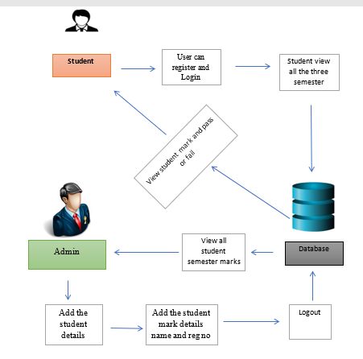
SYSTEM ARCHITECTURE

Slide 11
MODULES
In this project has two modules:
Admin
User

Slide 12
Admin
Login the account with the correct username and password
Add the student details
There is three button
Semester 1 Semester2 and Semester 3
Admin can add the semester mark with the student register no and name
For Each semester: 5 subjects 2 lab
View all marks
Logout

Slide 13
Student
Login the account with the correct credentials
Student can view all the three semester mark details
Like subject, mark, Pass/fail
Logout

Slide 14
HARDWARE REQUIREMENTS
System : Dual core.
Hard Disk : 40 GB.
Floppy Drive : 1.44 Mb.
Monitor : 15 VGA Colour.
Mouse : Logitech Mx Master 3.
Ram :4GB.

Slide 15
SOFTWARE REQUIREMENTS
Operating system : Windows 7/10.
Coding Language : JAVA
Front End : NetBeans Software
Backend : MySQLyog Community 32

Slide 16
FUTURE WORK
In near future, the system interface could be improved, with more attractive, interactive and meaningful images; enhance the system with an email and SMS or email notifications. Enhance the current system by computerizing almost all the services provided by the institution ,turning it into a complete LMS. And evolve the system by developing several versions through users feedback. if a complete solution has not been worked out.

Slide 17
CONCLUSION
our proposed system will help to overcome this disadvantage. Thus we can produce Marksheet for all student semesters . This system will help to create dynamic pages so that for implementing such a system we can make use of the different tools are widely applicable and free to use also

Slide 18
REFERENCE
Akinmosin James (2014). Automated Students Result Management System using
Oracle’s Database, Forms and Reports. Journal of Information Engineering and Applications. [4]. Walia S. and Gill K. S. (2014). A Framework for Web-based Student Record
Management System using PHP. International Journal of Computer Science.

Slide 19
THANKS!
Any questions?
You can find me at
Reach us – 1croreprojects@gmail.com
Contact / Whatsapp: 7708 150 152 / 9751 800 789 / 790 432 0834

